Slide 1

Seasonal Agriculture Performance Analysis
Student Name - Swoasti Bhattacharjee
College Name - Kalinga Institute of Industrial Technology
AICTE STU ID : STU6a5f3bb6e2e4e1784626102

Slide 2

PROBLEM STATEMENT
Agricultural activities are influenced by seasonal variations in environmental conditions, farming practices, resource availability and market conditions. As a result, agricultural performance may differ from one season to another.
However, raw agricultural data does not clearly explain how agricultural performance changes across seasons or what patterns can be observed in different seasonal conditions.
The problem is to analyze the given agricultural dataset and investigate seasonal differences in agricultural performance by identifying meaningful patterns, trends, relationships and variations within the available data.

Slide 3
Project Description Seasonal Agriculture Performance Analysis is a data analytics project that examines how agricultural performance varies across the Kharif, Rabi, and Zaid seasons. The project involves data cleaning, exploratory data analysis, and visualization to study crop yield, profitability, irrigation practices, and environmental factors. By comparing seasonal trends and identifying relationships between farming conditions and outcomes, the analysis uncovers key patterns affecting agricultural productivity. The insights generated can support better resource management, crop planning, and data-driven decision-making in agriculture.

Slide 4

WHO ARE THE END USERS?
Farmers — season-specific guidance on irrigation method and crop choice
Agricultural policymakers — evidence for seasonal planning and support schemes
Agribusiness & agri-input companies — demand planning by season and crop
Financial institutions & crop insurers — risk assessment by season
Researchers & data analysts — a reference seasonal performance data dataset

Slide 5

Technology Used
Python — core analysis language
Pandas & NumPy — data cleaning and manipulation
Matplotlib & Seaborn — data visualization
Jupyter Notebook — documented, reproducible analysis workflow

Slide 6
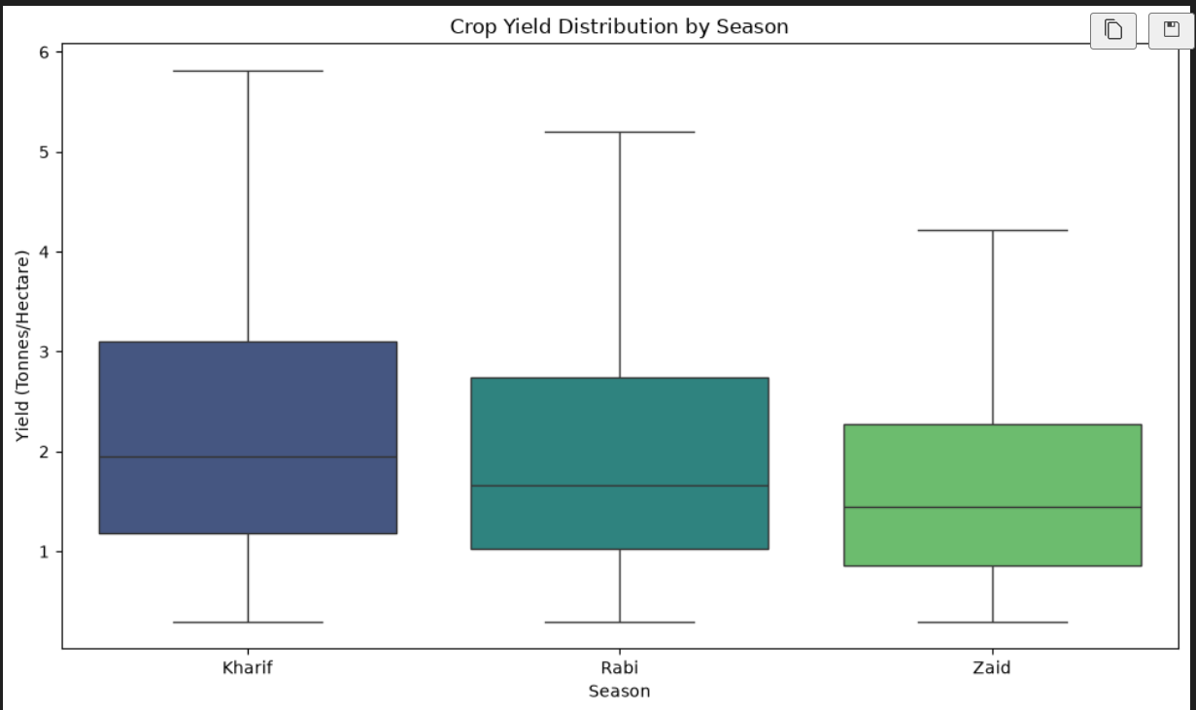
RESULTS
Crop Yield Differs Significantly Across Seasons

Slide 7
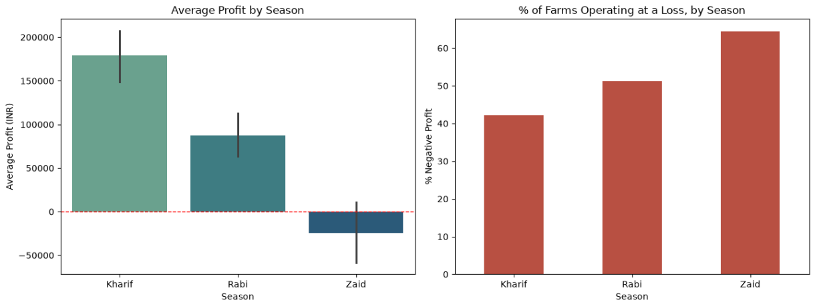
RESULTS
Profitability Declines Sharply From Kharif to Zaid

Slide 8
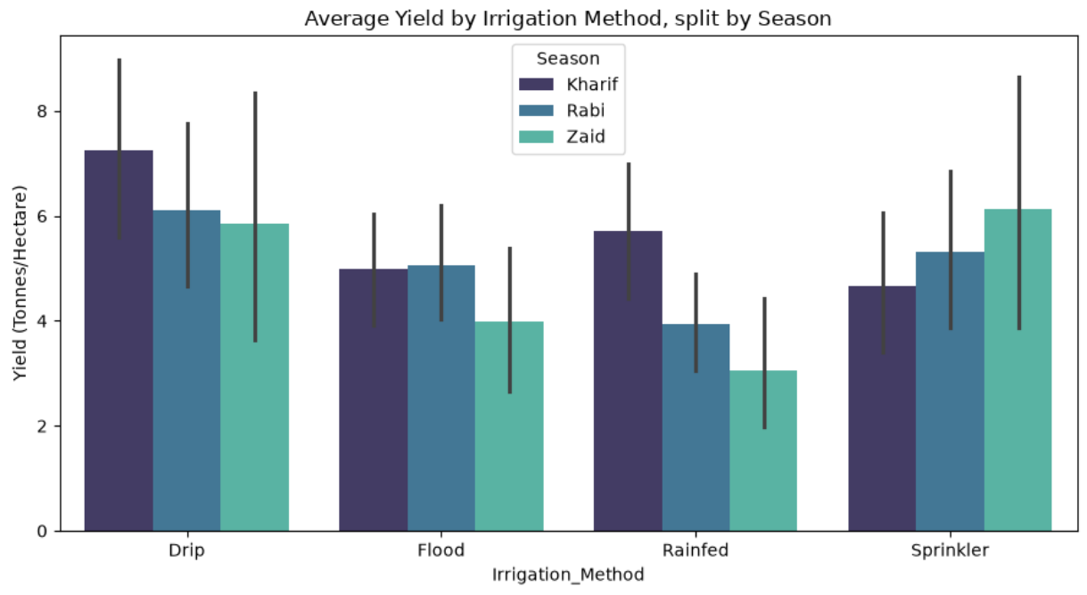
RESULTS
Irrigation Method Effectiveness Depends on Season

Slide 9
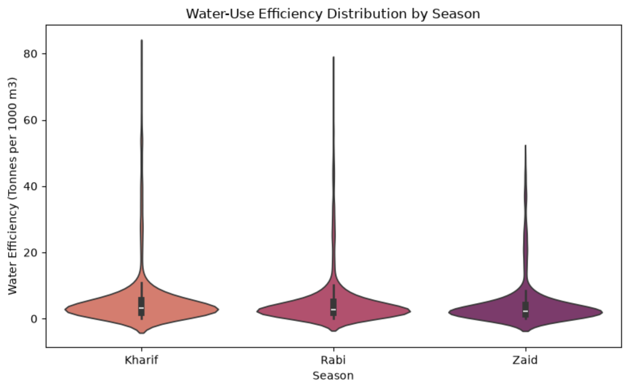
RESULTS
Water-Use Efficiency Varies by Season

Slide 10
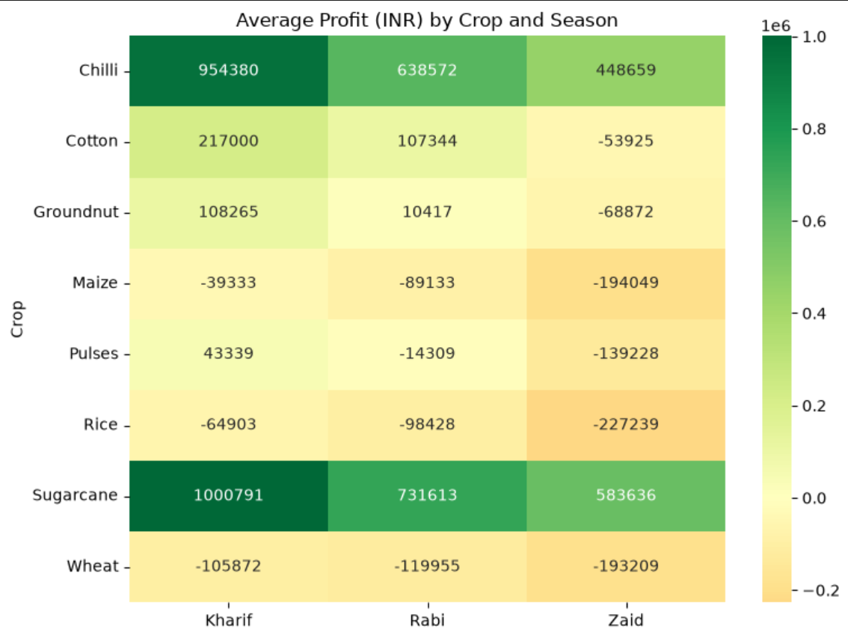
RESULTS
Crop Profitability by Season

Slide 11
Future scope
The analysis can be extended by incorporating multi-year agricultural data to identify long-term seasonal trends and improve the reliability of insights. Machine learning models can be developed to predict crop yield and profitability based on environmental and farming conditions. Future work may also include region-wise analysis to examine whether seasonal patterns remain consistent across different geographical areas. Integration of real-time weather and market data could further enhance decision-making and agricultural planning. Additionally, interactive dashboards can be developed to provide farmers and policymakers with actionable, data-driven recommendations for resource allocation and crop selection.
This future scope aligns well with the project's objective of understanding seasonal agricultural performance and supporting evidence-based agricultural planning.

Slide 12
GitHub Link
https://github.com/Swoasti07/Seasonal-Agriculture-Performance-Analysis

Slide 13

VOIS Course completion certificate - Course name- Data Visualization

Slide 14
Thank you
.
.

